Slide 1
HOSPITAL MANAGEMENT SYSTEM
SET – 5
INF 6210: Database Management Database Design
Instructor: Prof. Mutsalklisana

Slide 2
Contents
JOIN
TYPES OF JOIN
INNER JOIN
LEFT JOIN
RIGHT JOIN
FULL JOIN
SELF JOIN
CROSS JOIN

Slide 3
JOINS
What are JOINS?
A SQL join clause combines records from two or more tables in a relational database. It creates a set that can be saved as a table or used as it is. A JOIN is a means for combining fields from two tables (or more) by using values common to each.
A JOIN is a means for combining fields from two tables by using values common to each.

Slide 4
WHY USE JOINS
In a normalized database, groups of data are stored in individual tables, and relationships are established between those tables to link related data - access data in different tables to carry out an operation affected by those relationships
To support the capability to access data in multiple tables, SQL allows you to create joins in a statement that define how data is accessed in multiple tables
Most commonly used in select statements, but can also be used in update and delete statements

Slide 5
TYPE OF JOIN STATEMENT
INNER JOIN: returns rows when there is a match in both tables.
LEFT JOIN: returns all rows from the left table, even if there are no matches in the right table.
RIGHT JOIN: returns all rows from the right table, even if there are no matches in the left table.
FULL JOIN: returns rows when there is a match in one of the tables.
SELF JOIN: is used to join a table to itself as if the table were two tables, temporarily renaming at least one table in the SQL statement.
CARTESIAN JOIN: returns the Cartesian product of the sets of records from the two or more joined tables.

Slide 6
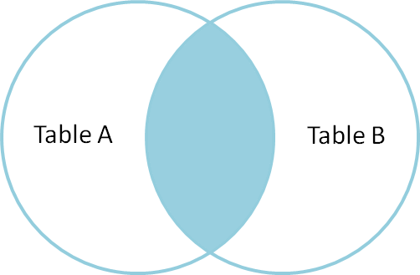
INNER JOIN
An inner join produces a result set that is limited to the rows where there is a match in both tables for what we're looking for.
If you don't know which kind of join you need, this will usually be your best bet.

Slide 7
INNER JOIN
The query is going to return the patient name and medicine taken by them for the medicines whose price is greater than 7000.

Slide 8
INNER JOIN
The query is going to return the list of all the patients with their room ID who are admit in ‘Semi-Private’ room.

Slide 9
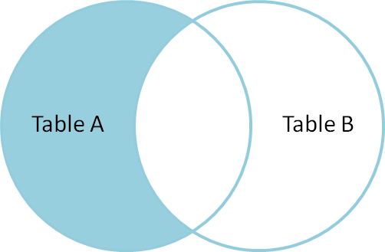
LEFT OUTER JOIN
A LEFT OUTER JOIN is one of the JOIN operations that allow you to specify a join clause. It preserves the unmatched rows from the first (left) table, joining them with a NULL row in the shape of the second (right) table.

Slide 10
LEFT OUTER JOIN
The query is going to return the list of all the nurses allotted to the emergency room type.

Slide 11
LEFT OUTER JOIN
The query is going to return the list of all the male nurses and the room allotted to them.

Slide 12
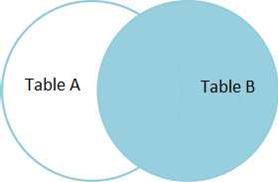
RIGHT OUTER JOIN
A RIGHT OUTER JOIN is one of the JOIN operations that allow you to specify a JOIN clause. It preserves the unmatched rows from the second (right) table, joining them with a NULL in the shape of the first (left) table. A LEFT OUTER JOIN B is equivalent to B RIGHT OUTER JOIN A, with the columns in a different order.

Slide 13
RIGHT OUTER JOIN
The query is going to return the list of the medicine given to the patient who are admitted after 1st January, 2014

Slide 14
RIGHT OUTER JOIN
The right outer join is performed on the patient and doctor table to retrive the list of all the patients attended by doctors.

Slide 15
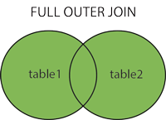
FULL JOIN
A full outer join, or just outer join, produces a result set with all of the rows of both tables, regardless of whether there are any matches. Similarly to the left and right joins, we call the empty spaces null.

Slide 16
FULL OUTER JOIN
This query is going to return the list of all the nurses and room from the database.

Slide 17
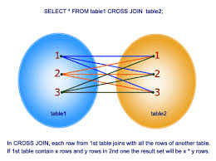
CROSS JOIN
The cross join returns a table with a potentially very large number of rows. The row count of the result is equal to the number of rows in the first table times the number of rows in the second table. Each row is a combination of the rows of the first and second table.

Slide 18
CROSS JOIN

Slide 19
THANK YOU

